Slide 1
Together, we can thrive
VERMONT CLIMATE ACTION PLAN
Public Engagement Event

Slide 2
What we’ll be talking about today
Why We Are Here
Why Action is Needed
Community Feedback
Climate Action Pathways
Participating in Solutions
Wrap-up

Slide 3
About the Vermont Climate Action Plan
Reduce harmful emissions and protect communities from climate impacts
Involve community members in the planning process to shape equitable solutions

Slide 4
Group process agreements
Participate as peers
Co-create brave space for learning
Share the air
Be present
Ideas go, IDs stay (confidentiality)

Slide 5
Introductions:
Please share your name, pronouns and why you’re here today.

Slide 6
WHY ACTION IS NEEDED
What are we facing?
healthvermont.gov

Slide 7
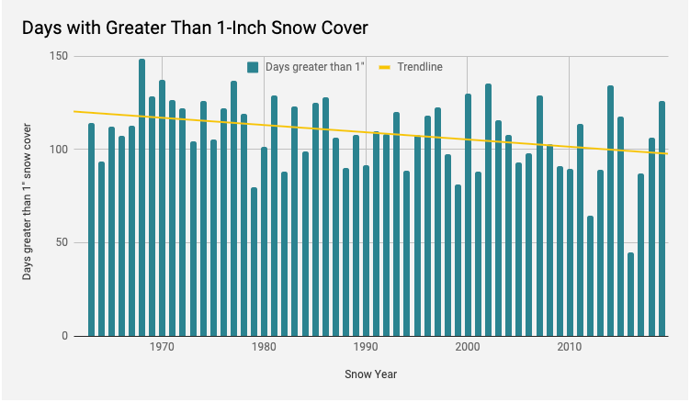
WHY ACTION IS NEEDED
What are we facing?
ncdc.noaa.gov

Slide 8
WHY ACTION IS NEEDED
What are we facing?
More rain and flooding
Changes to farming and sugaring
Different forests
Health concerns
Not everyone is impacted equally

Slide 9
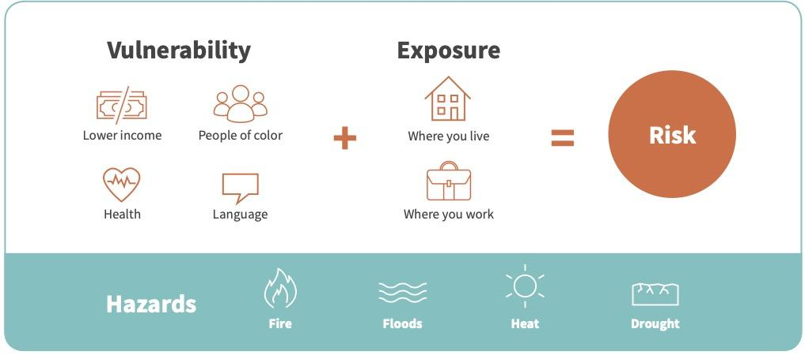
WHY ACTION IS NEEDED
People aren’t affected equally
washington.edu

Slide 10
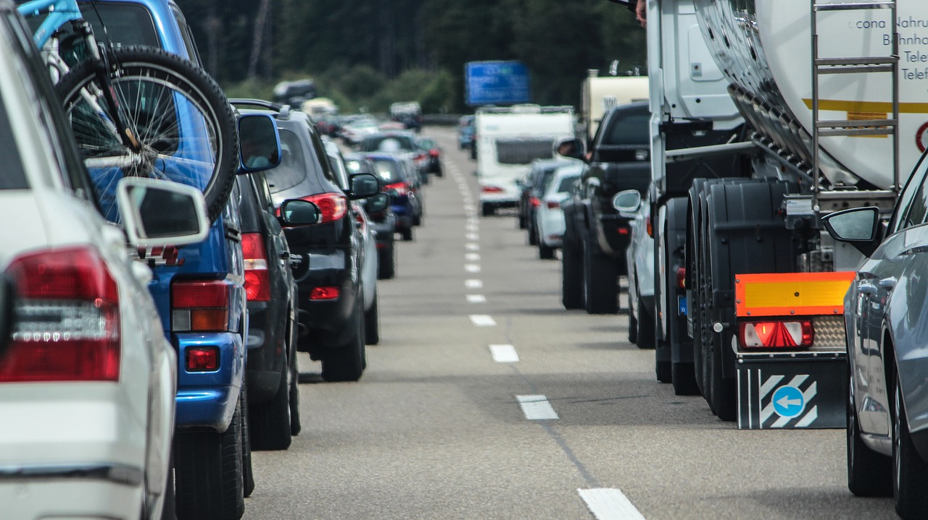
WHY ACTION IS NEEDED
Acting now matters
These changes
aren’t locked in
This Photo by Unknown Author is licensed under CC BY-ND

Slide 11
WHY ACTION IS NEEDED
Acting
now
matters

Slide 12
LET’S DISCUSS:
What climate change impacts are you most concerned about (for Vermont, your community, and you personally) and why?

Slide 13
Pathways

Slide 14
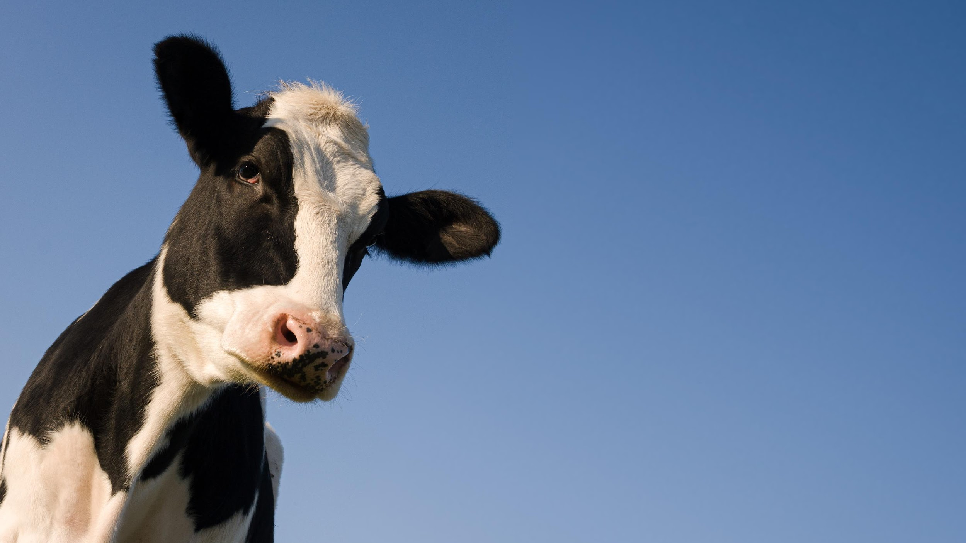
Sustain and Expand Carbon Capture and Storage in Vermont’s Natural and Working Lands, Soils and Waters
Sustain, Restore and Enhance the Health of Vermont’s Natural Working Lands, Soils and Water
Support Vermont’s Farmers, Foresters and Land Workers to Cut Climate Pollution and Increase Resilience to Impacts
Grow and Connect Local, Sustainable Natural and Working Land Economies, Markets and Food Systems
Resilient Agriculture and Ecosystems

Slide 15
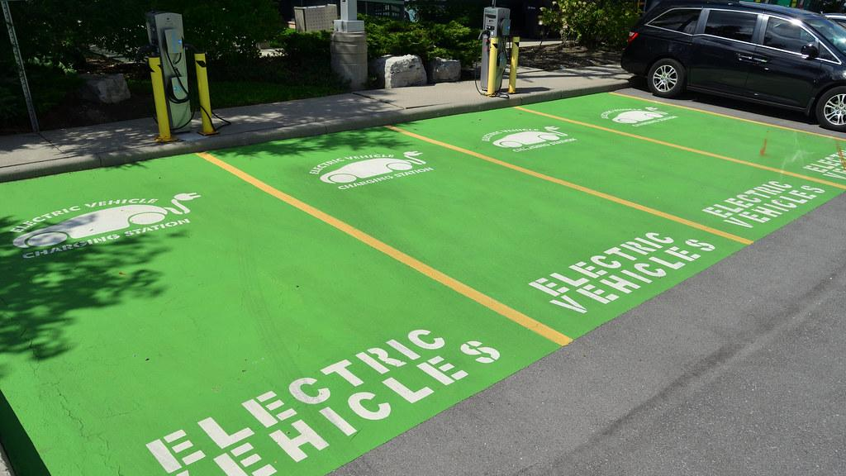
Electrify Transportation
Opportunities to Advance Low Carbon Fuels
Increase Transportation Choices
Land Use and Smart Growth
Efficient Transportation Systems and Vehicles

Slide 16
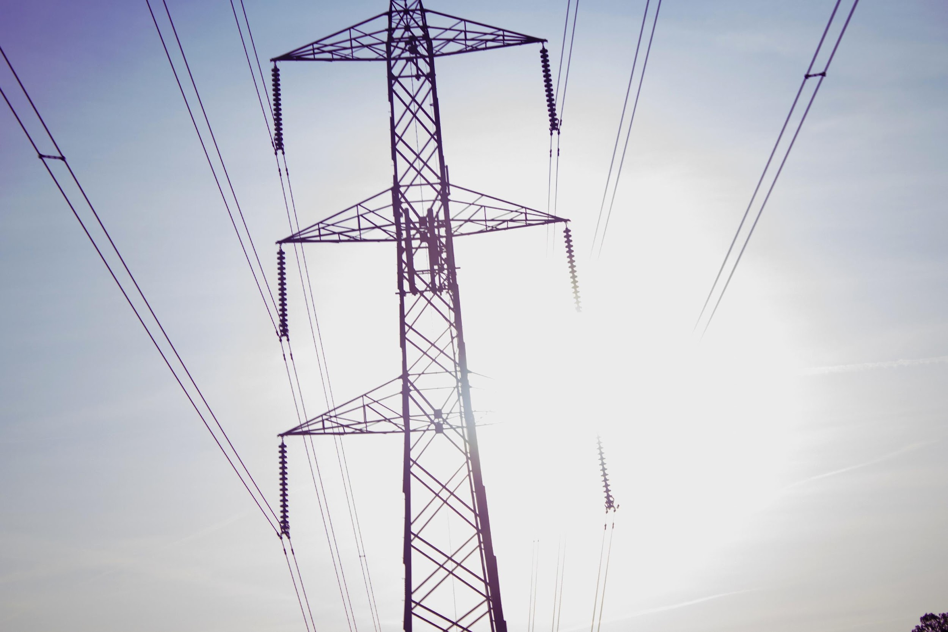
Achieve 100% Renewable Electricity Supply Statewide
Manage Energy Use to Limit Cost Impacts and Climate Pollution
Access to Electrification for Alll
Access to Clean, Reliable Energy

Slide 17
Building Enhancement Through Weatherization at Scale
Better Heating Through a Clean Energy Standard
Better Buildings

Slide 18
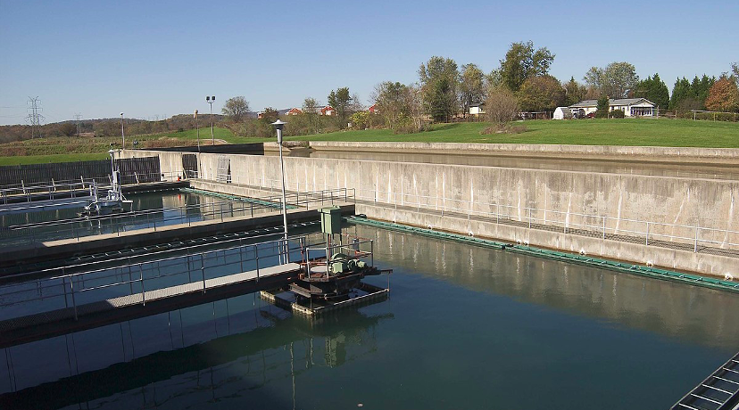
Cut Climate Pollution from Wastewater Treatment Facilities
Reduce Emissions from Industry
Leverage, Expand and Adapt Agricultural Programs that Deliver Climate Benefits
Invest in Working Lands Conservation and Education
Foster Partnerships to Generate Strategies for Farmers to Address Climate Change
Climate Action in Waste, Industry and Agriculture

Slide 19
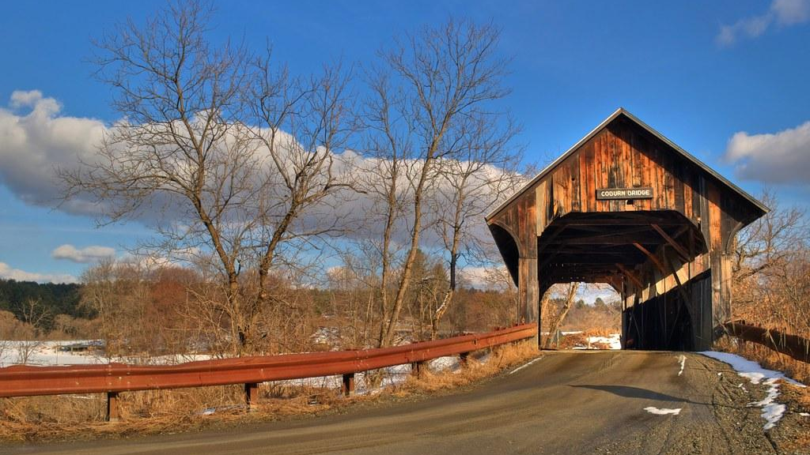
Increase Local and Regional Resilience Capacity
Enhance Resilience in Transportation, Communications, Water/wastewater and Energy Infrastructure
Support the Reduction of Fossil Fuels in Municipalities, School Districts and Residences.
Promote Resilient Land Use
Strong Rural Communities
This Photo by Unknown Author is licensed under CC BY-NC

Slide 20
LET’S DISCUSS: What’s your reaction to the pathways?
What do you like?
What would you change?
What’s missing?

Slide 21
NEXT STEPS
Take the survey
Join the conversation
on social media
Host your own event
Keep in touch!
info@climateaccess.org

Slide 22
Thank you!

