Slide 1
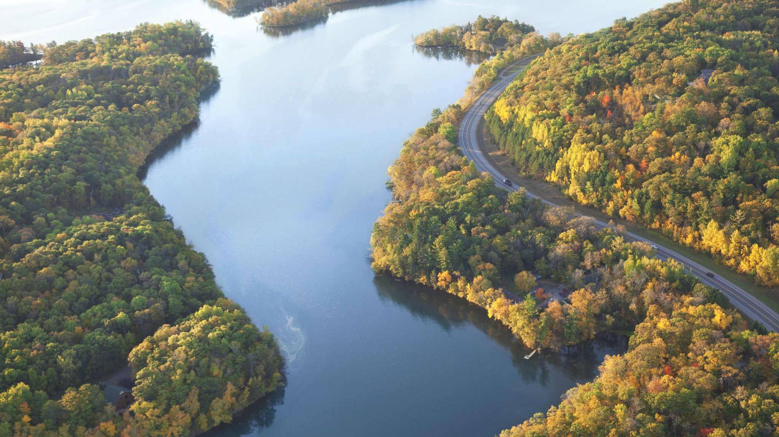
Pathways Framework
For VCC Ag and Ecosystems 9 July 2021

Slide 2
Levels of Organization
Values (co-created through discussion at the SC)
Pathways (suggested by TG leads and finalized by SC)
Strategies (initiated by TGs)
Actions (initiated by TGs)
Measurable Outcomes (maybe late Summer and Fall) (initiated by TGs)

Slide 3
Common Pathways for SC
Maintain and expand carbon sequestration and storage in Vermont’s natural and working lands
Enhance and empower Vermont’s natural and working lands to help both natural and human communities adapt to climate change
Support Vermont’s farmers, foresters, and land workers to reduce greenhouse gas emissions from their operations
Support and empower Vermont’s natural and working lands owners, managers, and caretakers and develop the workforce
Grow and connect local, sustainable natural and working lands economies and markets and provide equitable access to them
Support healthy agricultural soils and local food systems
Shape land use and development that supports natural and human communities for a sustainable, equitable future

