Slide 1
Vermont Climate Council
Electric Task
Cross-Sector Mitigation Subcommittee
Co-Chairs: _______

Slide 3
Electric Task Leads
List task Leads here:
Developed with input from:
List those that helped task lead develop pathways and strategies:

Slide 4
Electric Task Process
List out brief summery of task progress here:
Participation
Public engagement
Meetings
Public comment
Workshop
Presentation

Slide 5
Leading with Equity as a Core Component
The term “Just Transitions” is a way of framing for government and business action on climate change. Its work encompasses both public policies and business action to deal with the impacts of industry transition away from greenhouse gas emissions for jobs and livelihoods (the transition "out") and aims to generate the low or zero greenhouse gas emission jobs and livelihoods of a sustainable society (the transition "in"). Guiding Principles for a Just Transition, June 2021

Slide 6
Guiding Principles for a Just Transition
Inclusive, Transparent & Innovative Engagement
Accountable & Restorative
Moving at the Speed of Trust
Solidarity
The Most Impacted First
Supports Workers, Families & Communities
Notes:
Draft guiding principles for a Just Transition. These are intended for the Council and subcommittees to evaluate as they develop their respective strategies and programming. The Guiding Principles are meant to spark dialogue within Subcommittees and to serve as a grounding checkpoint to ensure the inclusion of equity. They will be especially useful in policy areas that might not traditionally be considered within an equity lens and would otherwise reinforce historically marginalized, disadvantaged and underserved communities.

Slide 7
Climate Action Plan recommendations must speak to key criteria:
Mitigation Strategies
(emissions reduction)
Justice and Equity
Co-Benefits
Short term priorities
Sequestration Strategies
Long term priorities
Cost Effectiveness
Feasibility
Resilience and Adaptation Strategies
Notes:
These principles set expectations regarding:
How Vermont’s Climate Council and its subcommittees will conduct their work;
What recommendations are made by the Council; and
How investments, implementation and oversight of climate action plans occur.

Slide 8
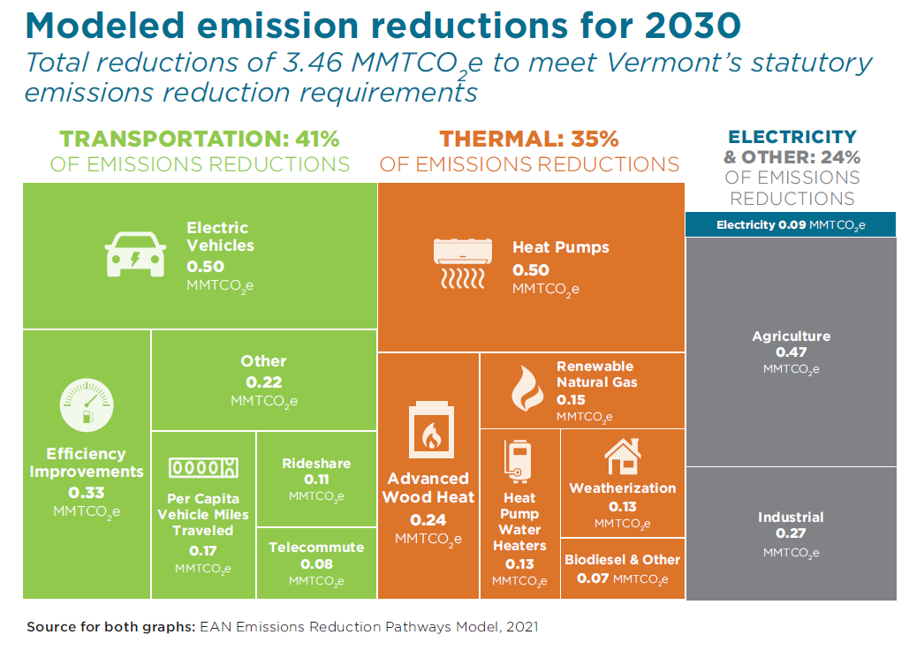
Electric Task Focus
List focus of task here:
Keep bullets short (a few works or short content titles)
Use EAN 2021 pathways graphics

Slide 9
Preliminary Modeling/Data
Use this slide to share any data, modeling, or graphics on the sector or focus of the task that frame up the need for action and the strategies that will be presented.
Sharing graphs, charts, or graphics are preferred to bulleted text.

Slide 10
High level vision/goal/reduction targets mandated by the GWSA

Slide 11
Climate Action Plan Recommendations
List out strategies and recommendations here:

Slide 12
Pathway #1 _____
List strategy here
List key strategies needed to work towards pathway
Use this box to include a key quotes, data point, etc. that help to frame up the detailed pathway and strategy text on the slide. Ensure quotes, data points, etc. are cited.

Slide 13
Pathway #2 _____
List strategy here
List key strategies needed to work towards pathway
Use this box to include a key quotes, data point, etc. that help to frame up the detailed pathway and strategy text on the slide. Ensure quotes, data points, etc. are cited.

Slide 14
Pathway #3 _____
List strategy here
List key strategies needed to work towards pathway
Use this box to include a key quotes, data point, etc. that help to frame up the detailed pathway and strategy text on the slide. Ensure quotes, data points, etc. are cited.

Slide 15
Pathway #4 _____
List strategy here
List key strategies needed to work towards pathway
Use this box to include a key quotes, data point, etc. that help to frame up the detailed pathway and strategy text on the slide. Ensure quotes, data points, etc. are cited.

Slide 16
Pathway #5 _____
List strategy here
List key strategies needed to work towards pathway
Use this box to include a key quotes, data point, etc. that help to frame up the detailed pathway and strategy text on the slide. Ensure quotes, data points, etc. are cited.

